Slide 1
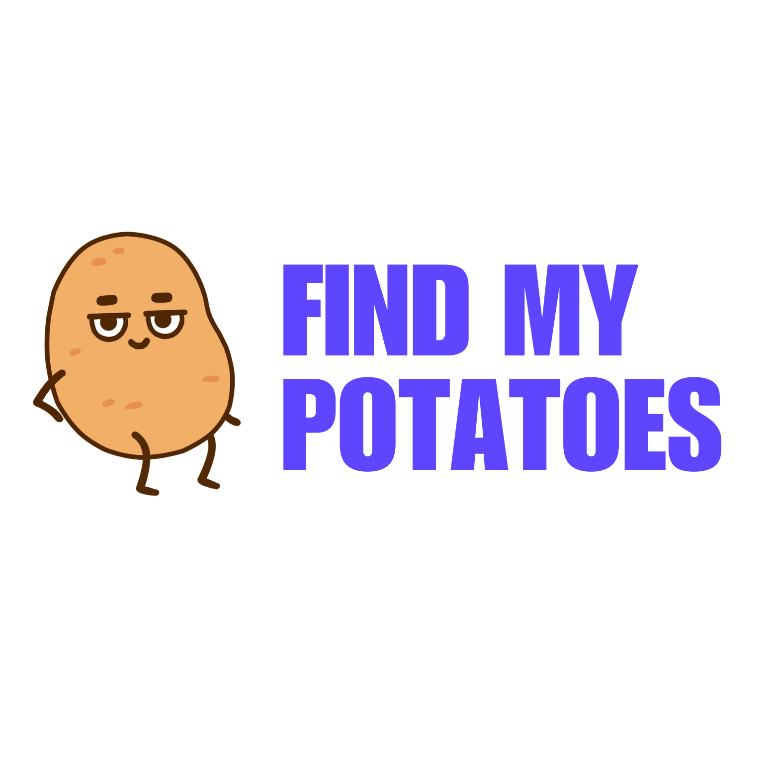
Find my potatoes is an innovative project that aims to simplify the process of discovering and navigating to specific types of places in unfamiliar areas.

Slide 2
WHATS THE PROBLEM?
Find places with certain specifications that satisfy the users preferences using a chat bot

Slide 3
What is your Solution?
the users can provide the chat bot their preferences
The chat bot provides options of places to go to
the bot will recommend a list of places that satisfies these preferences on the map .

Slide 4
What Technologies we used?
It uses cohere and LangChain to make sense of the data with python logic, and deployed locally using StreamLit.io

Slide 5
How will this application make Money?
Local Ads
Referral Fees
Partnership with tourisum companys

Slide 6
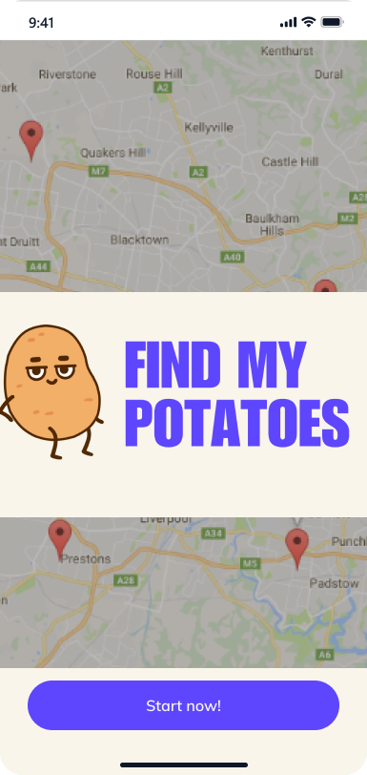
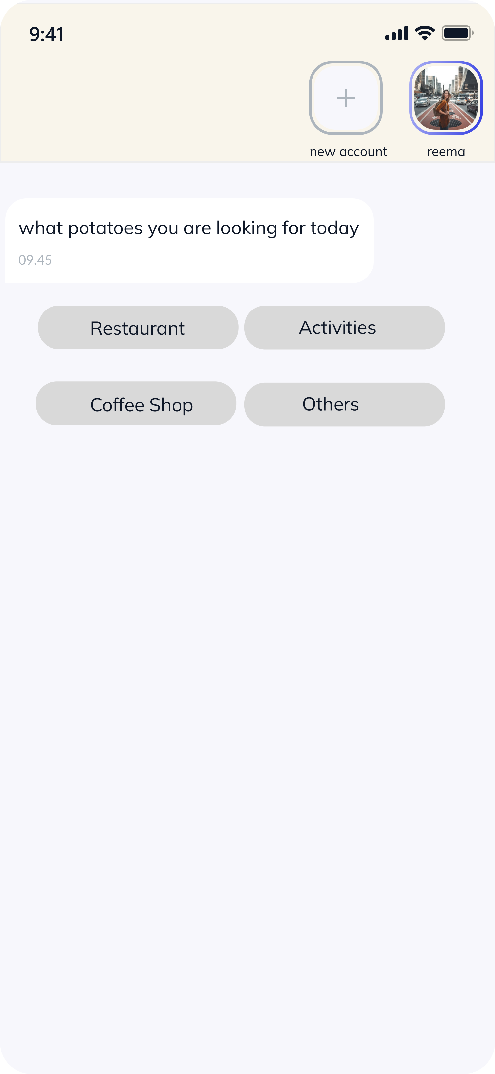
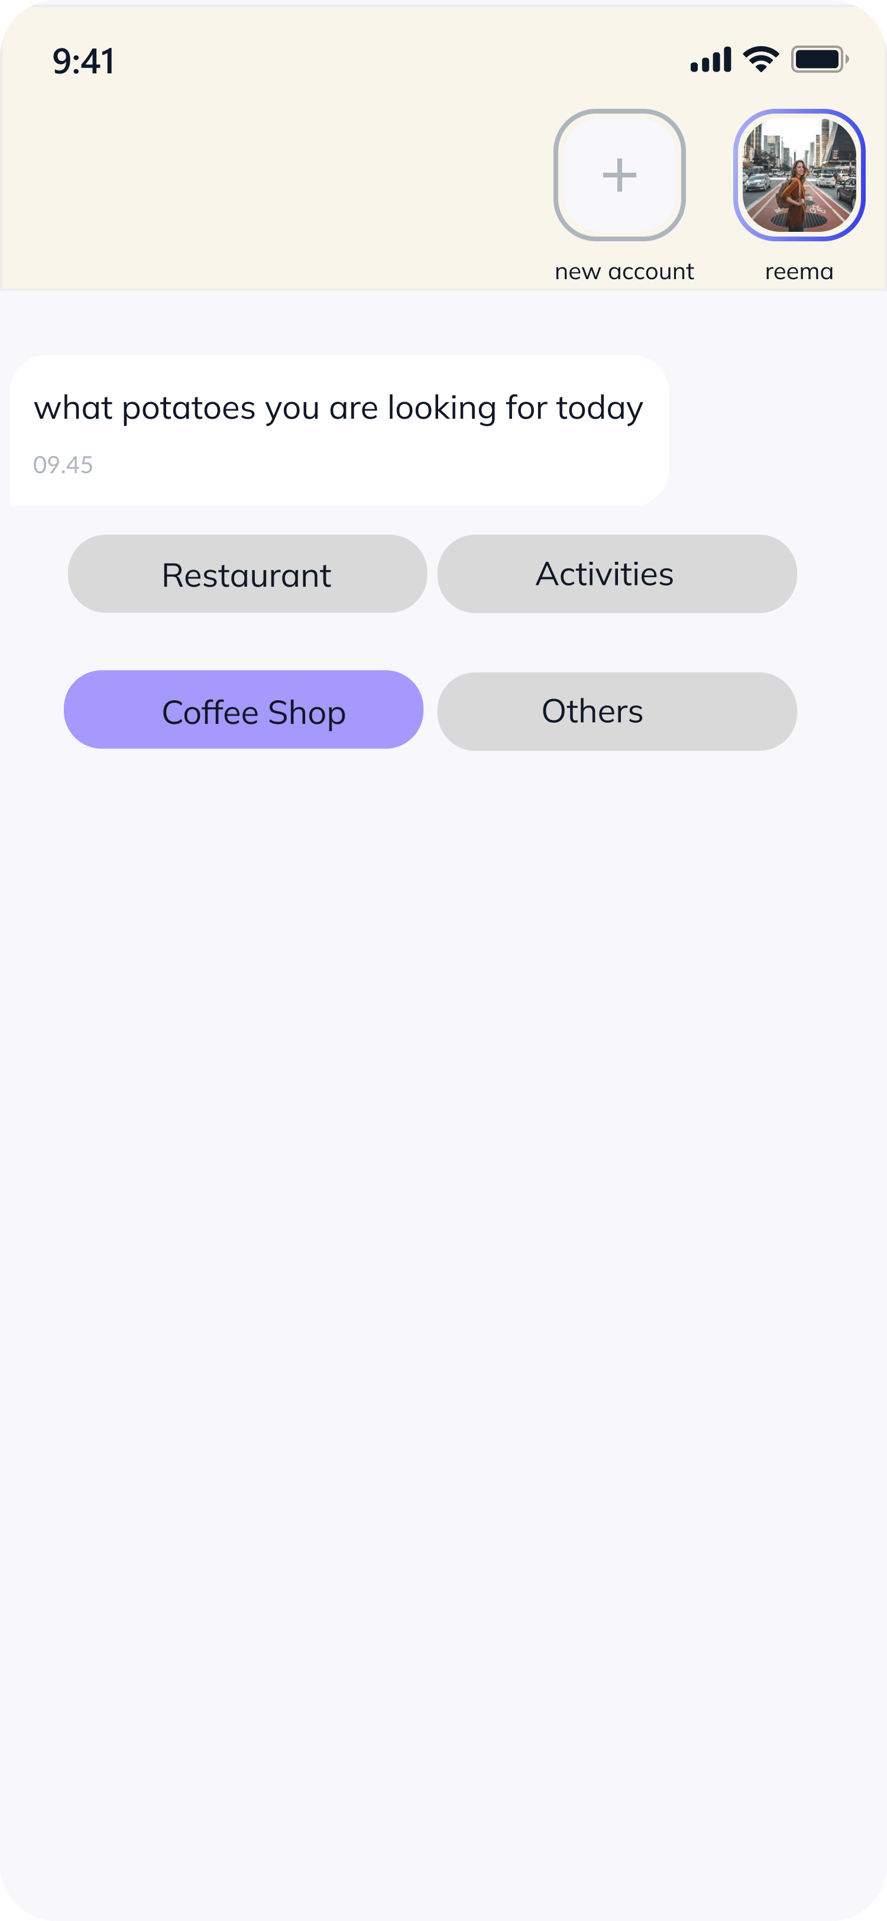
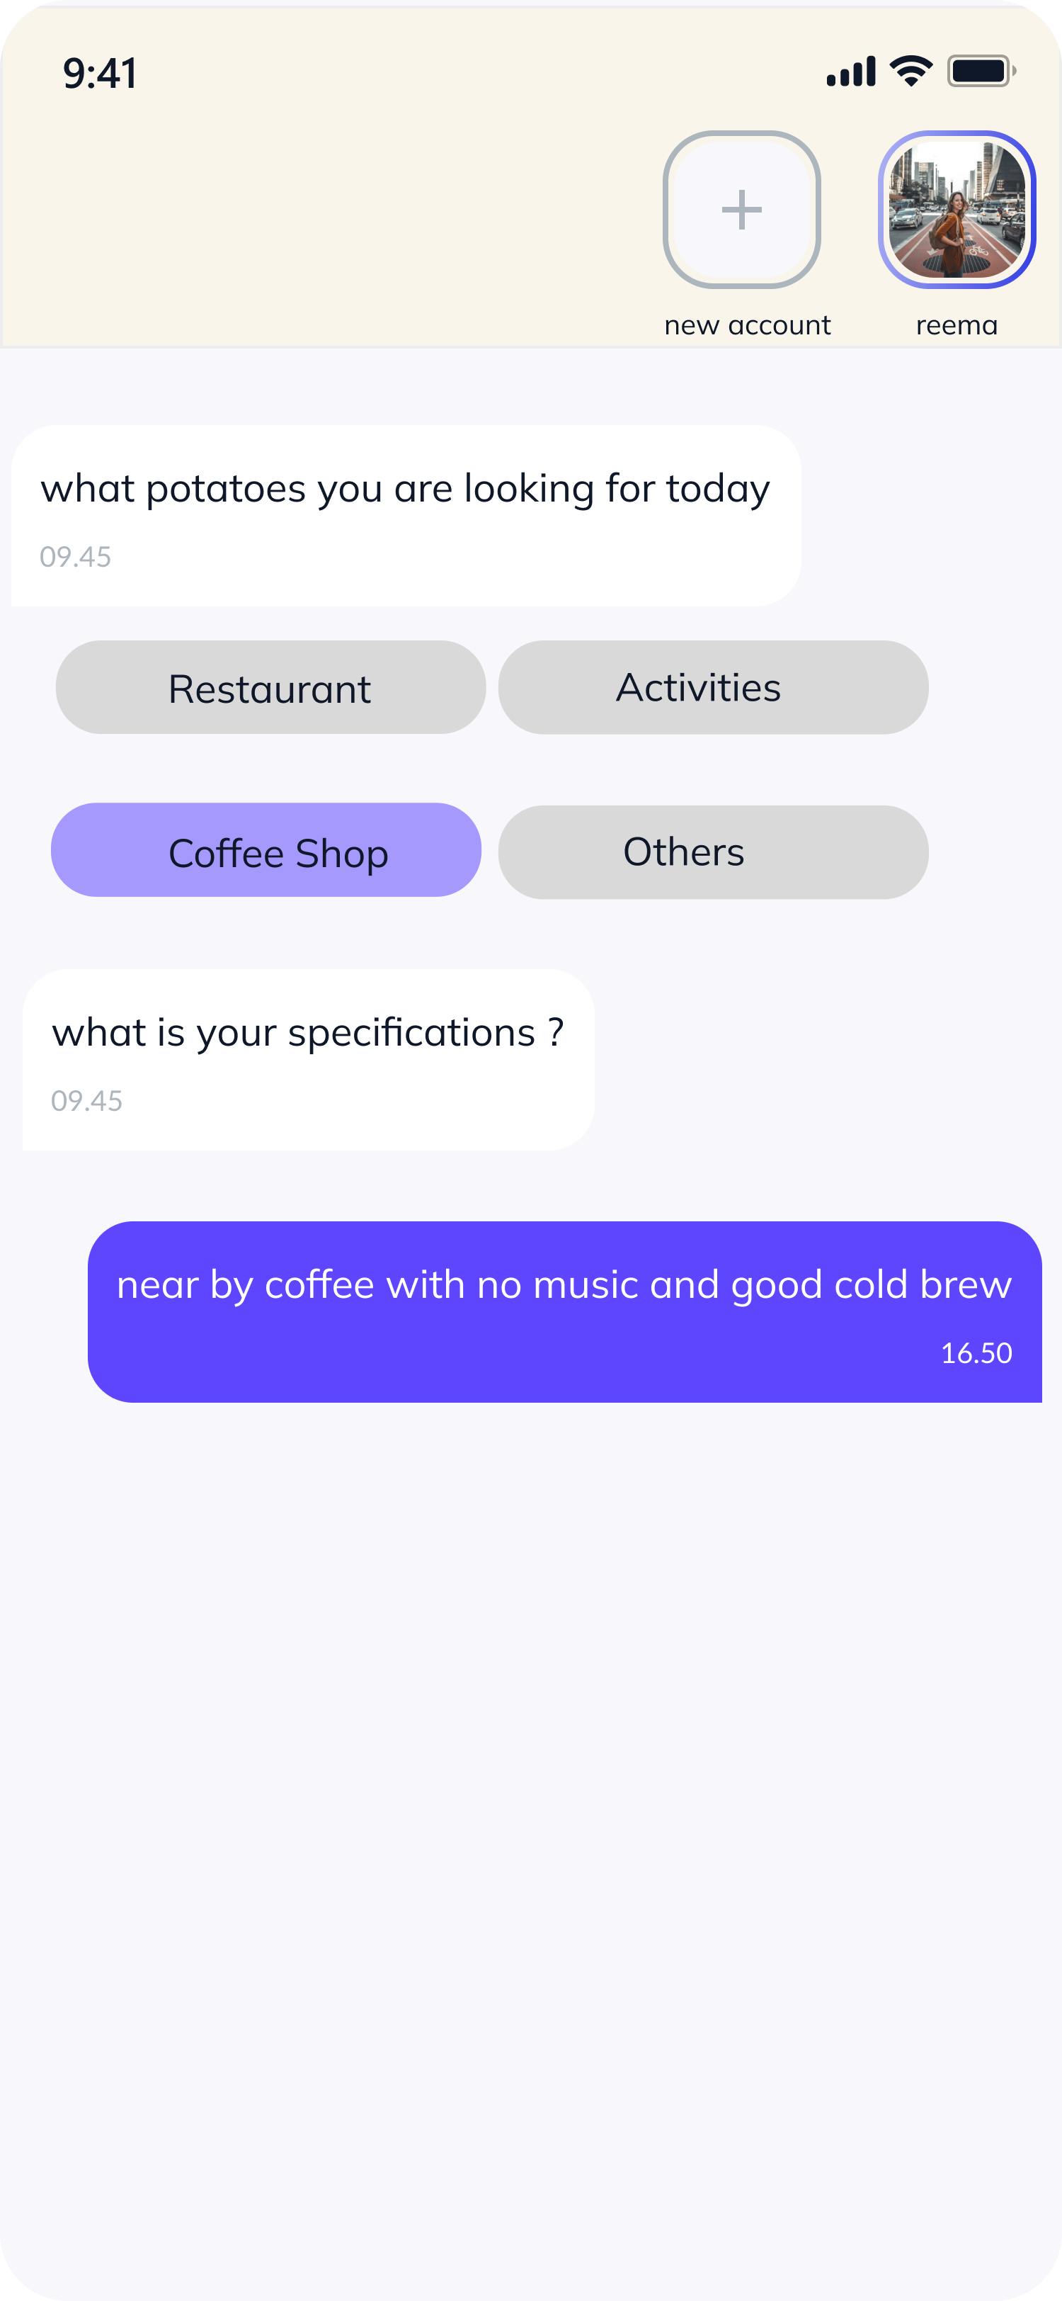
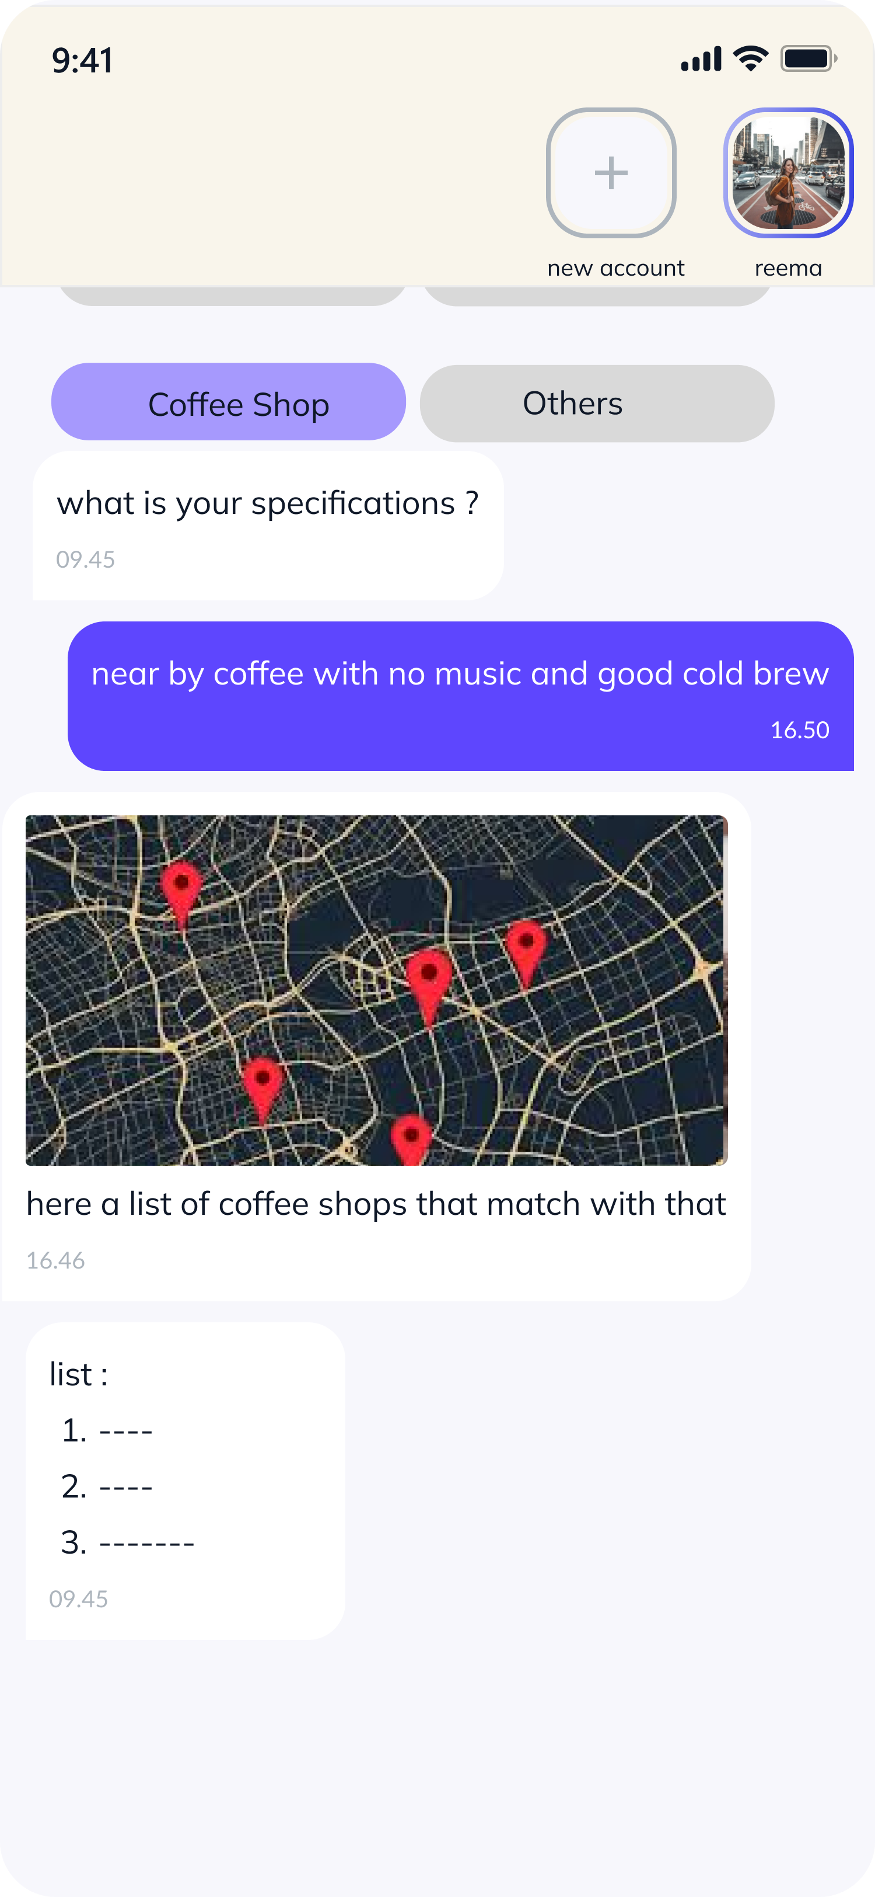

Slide 7
What is the Future?
The next steps for product development include improving natural language processing and personalizing responses for individual.
Support multiple resources: we want to make sure that our system can handle data from variety of sources, such as Google Maps and Four Squere.
Implement recommendation model to recommend alternative places based on the user preference history.

Slide 8
TEAM NAMES
Mercury AiAicha Rikli عائشة ريكلي
Afra Alalawi عفراء العلوي
Wajd Mohammed وجد محمد
Reema al twuaijri ريما التويجري
Ragad Alrowili رغد الرويلي
Sheikha Alrasheed شيخه الرشيد

